Slide 1

New Hike and Backpack Leader Seminar
Tacoma Hiking & Backpacking Committee
Notes:
Lisa
Welcome and Introductions
Lisa Elliott, Hiking and Backpacking Leader Seminar Instructor
Beth Lowe: Backpacking Co-Chair
Carolyn Carbajal: Backpacking Co-Chair
Diann Sheldon: Hiking Co-Chair
David Hyde: Hiking Co-Chair
Thank you for your interest in leading hikes or backpacks for the committee, without people like you we won’t have a committee.
Introductions of board and REMEMBER TO HAVE PARTICIPANTS INTRODUCE THEMSELVES

Slide 2
Mountaineers
A Relationship Beyond Land Acknowledgements
The Mountaineers acknowledge that we are on the lands of the Pacific Northwest Indian tribes, who live here and steward these lands and waters as they have since time immemorial. As we pursue our mission, we strive to listen to and amplify Native traditions and values through respectful engagement.
Notes:
Lisa
2024 Read Position Statement
The Mountaineers acknowledge that we are on the lands of the Pacific Northwest Indian tribes, who live here and steward these lands and waters as they have since time immemorial. As we pursue our mission, we strive to listen to and amplify Native traditions and values through respectful engagement.

Slide 3
Objectives
Become Familiar with Hike and Backpack Leader Certification Requirements for Tacoma Mountaineers
Learn Roles and Objectives of a Leader in the Mountaineers
Develop Leadership Techniques by applying them in scenarios
Notes:
Lisa
Become Familiar with Hike Leader Certification Requirements for Tacoma Mountaineers
Learn Roles and Objectives of a Leader in the Mountaineers
Develop Leadership Techniques and apply them in scenarios

Slide 4
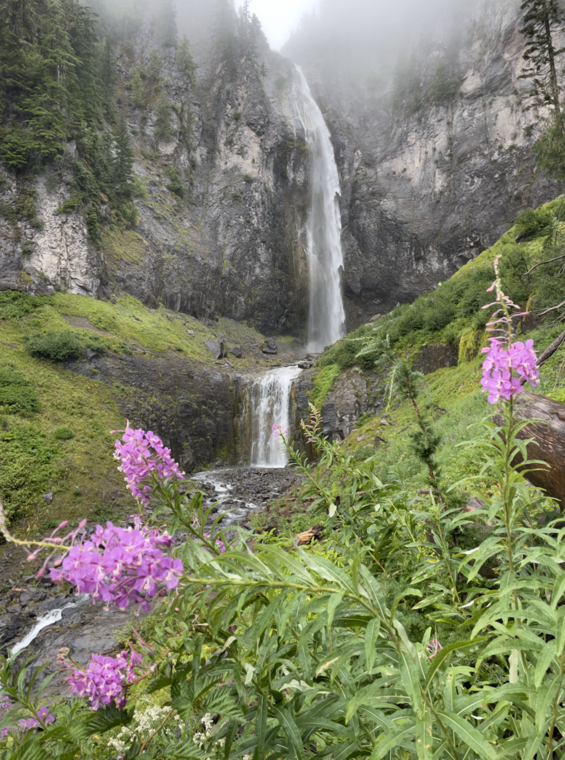
Steps to Becoming a Hike Leader
Prerequisites
Complete in Any Order
  New Hike & Backpack Leader Seminar: Attend this seminar—from any branch.
  Online Application: Submit your application online. Be sure to specify Tacoma Branch. You should receive confirmation of your application within a few days.
  First Aid Training: Complete either Wilderness First Aid (WFA) or Medical First Aid (MOFA). Trail Emergency Preparedness is acceptable providing you complete either WFA or MOFA within one year.
  Navigation Training: Complete either the Wilderness (off-trail) Navigation or Staying Found (on-trail) navigation course.
Notes:
David
Hike Leader
Prerequisites (Complete in Any Order):
New Hike & Backpack Leader Seminar: Attend this seminar—from any branch.
Online Application: Submit your Hike Leader Application online. Be sure to specify Tacoma Branch. You should receive confirmation of your application within a few days.
First Aid Training: Complete either Wilderness First Aid (WFA) or Medical First Aid (MOFA). Trail Emergency Preparedness is acceptable providing you complete either WFA or MOFA within one year.
Navigation Training: Complete either the Wilderness (off-trail) Navigation or Staying Found (on-trail) navigation course.

Slide 5
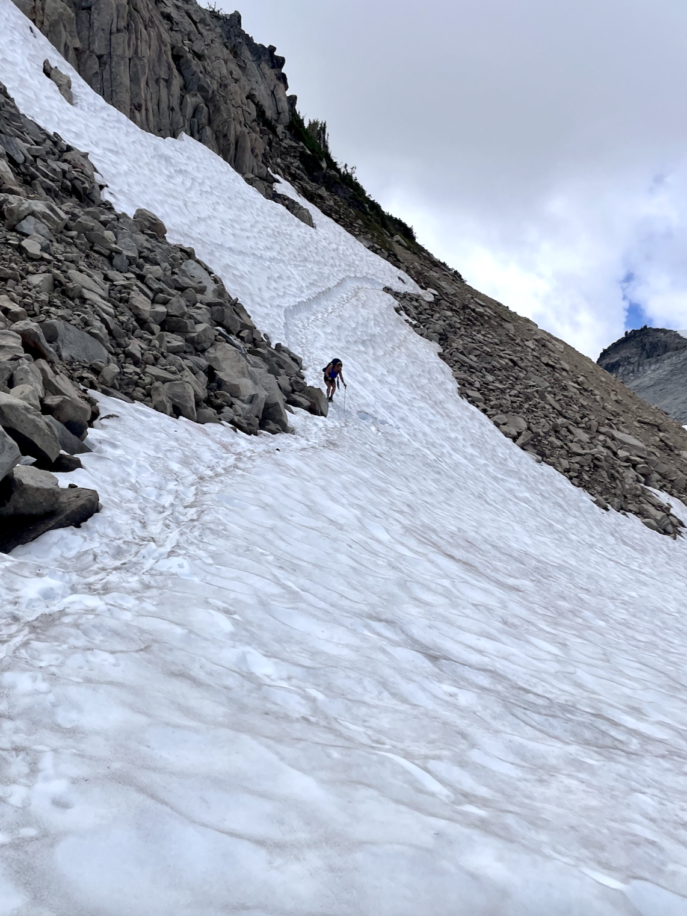
Steps to Becoming a Hike Leader
Mentored Hike:
  Mentored Hike: The committee will approve a mentor, and then your final step is to successfully lead a mentored hike. The committee will then approve your Hike Leader Badge.
Notes:
David
Mentored Hike:
Mentored Hike: The committee will approve a mentor, and then your final step is to successfully lead a mentored hike. The committee will then approve your Hike Leader Badge.

Slide 6
Steps to Becoming a Backpack Leader
Prerequisites
Complete in Any Order
  Lead two day hikes: Become a hike leader and lead two day hikes.
  Backpack Skills: Earn a Basic Backpack Skills Badge.
  Online Application: Submit your online application. You should receive confirmation of your application within a few days.
  Assistant Lead: Be an Assistant Lead on one Tacoma Branch backpack trip. Similar Mountaineer overnight trips from other committees may be accepted.
Notes:
Beth or Carolyn
Prerequisites (Complete in Any Order):
Lead two day hikes: Become a hike leader and lead two day hikes.
Backpack Skills: Earn a Basic Backpack Skills Badge.
Online Application: Submit your online Backpack Leader Application . You should receive confirmation of your application within a few days.
Assistant Lead: Be an Assistant Lead on one Tacoma Branch backpack trip. Similar Mountaineer overnight trips from other committees may be accepted.

Slide 7
Steps to Becoming a Backpack Leader
Mentored Backpack
  Mentored Backpack: The committee will approve a mentor, and then your final step is to successfully lead a mentored backpack. The committee will then approve your Backpack Leader Badge.
Notes:
Beth or Carolyn:
Mentored Backpack:
Mentored Backpack: The committee will approve a mentor, and then your final step is to successfully lead a mentored backpack. The committee will then approve your Backpack Leader Badge.

Slide 8
Active Mountaineer Alternate Path
Leaders from other committees (e.g., Scrambling, Climbing, Snowshoe, etc.) can become Backpacking Leaders directly, without needing to become Hike Leaders and leading two day-hikes first
or
you can earn both badges concurrently
Notes:
Beth or Carolyn

Slide 9
Committee Approval
What We Look For in Leaders
Technical Skills | Soft Skills
Skills as demonstrated on 3 prior trips | Caring, service-focused, respectful, empathetic
First-aid, Navigation, 10 Essentials | Safety-Oriented
Use of Leave No Trace (LNT) | Group Leadership
Mountain Safety: identify & mitigate/avoid common hazards | Trip Planning
Knowledge of The Mountaineers Standards and Land Management Agency Policies | Communication
Notes:
Beth or Carolyn

Slide 10
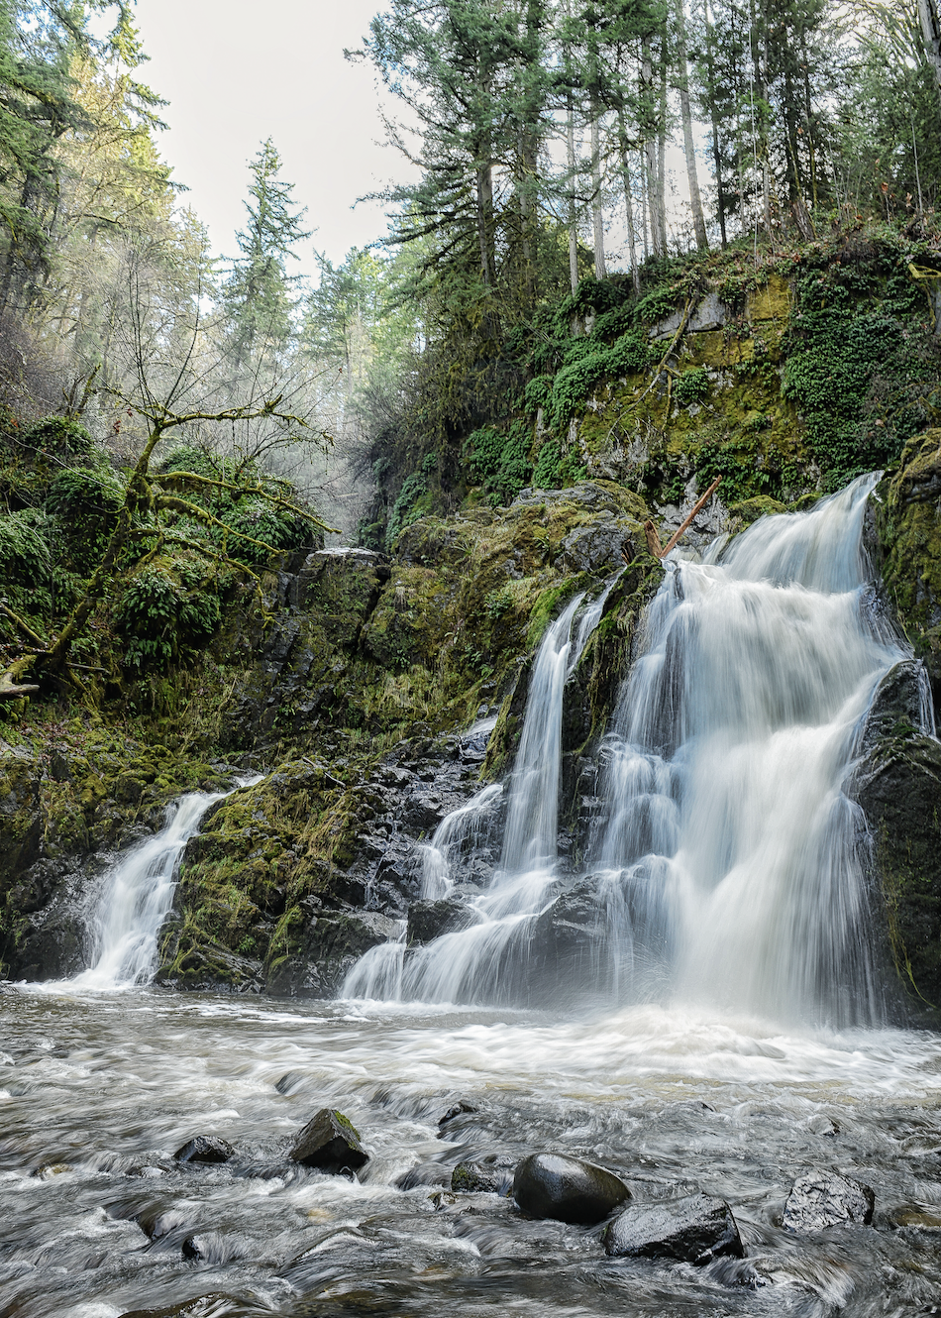
Maintaining Hike and Backpack Leader
  Hike leaders must lead at least two trips per year.
  Backpack leaders must lead any combination of the following per year:
    a. Two overnight trips OR
    b. One day hike and one overnight backpack trip OR
    c. One multi-night backpack trip.
  Be in adequate physical and mental condition to properly lead each hike or backpack scheduled.
  Meet and follow the Minimum Club-wide Standards for Hiking and Backpacking as outlined on the Mountaineers website.
Notes:
Beth or Carolyn
Hike leaders must lead at least two trips per year.
Backpack leaders must lead any combination of the following per year:
Two overnight trips OR
One day hike and one overnight backpack trip OR
One multi-night backpack trip.
Be in adequate physical and mental condition to properly lead each hike or backpack scheduled.
Meet and follow the Minimum Club-wide Standards for Hiking and Backpacking as outlined on the Mountaineers website.

Slide 11
Roles and Objectives of a Leader
Why Lead?
To provide our participants with a broad range of experiences and activities, we need a diverse group of leaders that represents our participants.
Leadership is a shift from a focus on individual success to group success.
Choose your own destinations, hike dates and types-pace of trips.
Become part of a community – gain new lifelong friends.
Notes:
Diann
In order to provide our members with a broad range of experiences and activities, We need a diverse group of leaders that represents our participants.
– hikes of varying distance and difficult, and both weekend and weekday offerings.
Leadership is a shift from a focus on individual success to group success
Choose your own destinations, hike dates and types-pace of trips.
Become part of a community – gain new lifelong friends.

Slide 12
Roles and Objectives of a Leader
Expectations:
Plan, organize and carry out activities.
Represent the Mountaineers & leave those you meet feeling great about their experience.
Accountability for the SAFE RETURN of your group.
Notes:
Diann
Plan, organize and carry out activities
Represent the Mountaineers, a 110 year old brand, by leaving your participants and those you meet on the trail feeling great about their experience
Accountability for the SAFE RETURN of your group

Slide 13
Roles and Objectives of a Leader
Responsibilities:
10 Essentials
Emphasize critical items in pre-trip communications.
Bring extras of especially critical items.
Teach and lead by example.
Notes:
Diann
10 E’s – carry and know how to use all of the Essentials
Emphasize critical items in the description and pre-trip communications.
Bring extras of especially critical items. If someone shows up without a piece of critical gear, see if someone else can share before leaving someone behind.
Teach and lead by example, but don’t be more rigid than the circumstances require for safety.

Slide 14
Leadership Techniques
Good Leaders Create Good Participants
Healthy Communication & Clear Expectation Setting
Expedition Behavior: Group-Oriented Behavior
Inclusive Decision Making
Be engaged with your group
Notes:
Diann
Healthy Communication & Clear Expectation Setting
Open, honest and humble communication (in both directions)
Clear expectations prevent most (non-emergency) issues
Expedition Behavior: Group-Oriented Behavior
Care for the group and care for yourself
“How can I support you?”
Inclusive Decision Making
Leverage group’s knowledge and concerns
Engage participants to “own” the trip success
Be engaged with your group

Slide 15
Leadership Techniques
Leadership Styles
Pacesetter
Authoritative
Coach
Democratic
Notes:
Diann Graphic Highlights how we might move in leadership style back and forth and across
Pacesetter – “Here we go! Follow me like this!”
Authoritative – “I’m the expert and this is what we should do.”
Coach – “Try this approach.”
Democratic – “What do you think we should do?”
There is no one right style. You will have a “default” style, but use them all as needed. Think about these and how/when to use them to maximize group success.

Slide 16
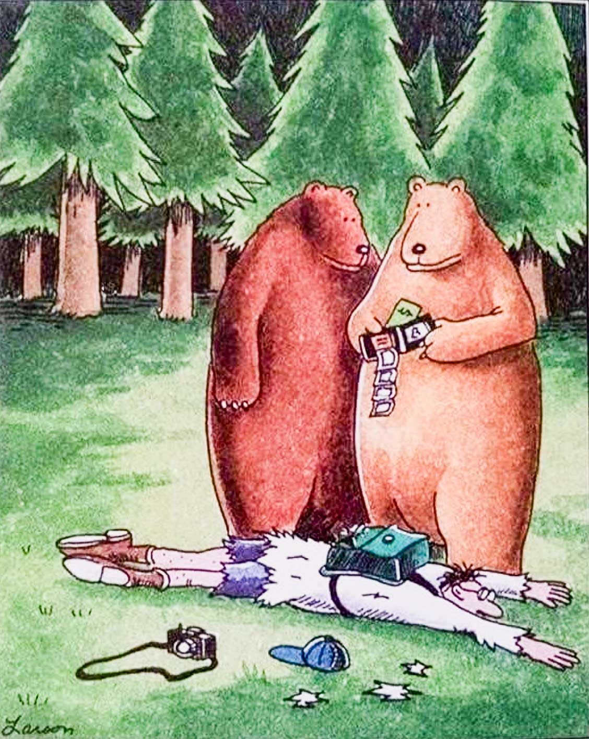
Leadership Techniques
Managing Conflict and Facing Challenges
Assume Positive Intent
Be Proactive
Be Discrete
Stay Calm
Listen with Intent
Identify the Problem, Issue or Concern
Acknowledge You Understand the Issue by Repeating it Verbally
Accommodate Safely
Notes:
Diann
Assume positive intent
Be proactive – don’t wait until tempers flare
Be discrete – don’t put someone on the spot or humiliate
Stay calm and manage your emotional state
Listen to their issue / concern with an open mind
Acknowledge You Understand the Issue by repeating their comments back verbally, Give example
If you can accommodate safely, do so

Slide 17
Leadership Techniques
Crisis Management Cycle
Assess
Situation
Make a Plan
Implement Plan
Re-assess Situation
Prevention
Stay Calm
Maintain Focus on the Big Picture
Keep the Group Together
Notes:
Diann
Prevention is the best approach
Stay calm and keep the group calm (don’t make the situation worse)
Crisis Management Cycle
Assess the situation
Make a plan
Implement the Plan
Re-assess the situation
Maintain focus on the big picture
Keep the group together

Slide 18
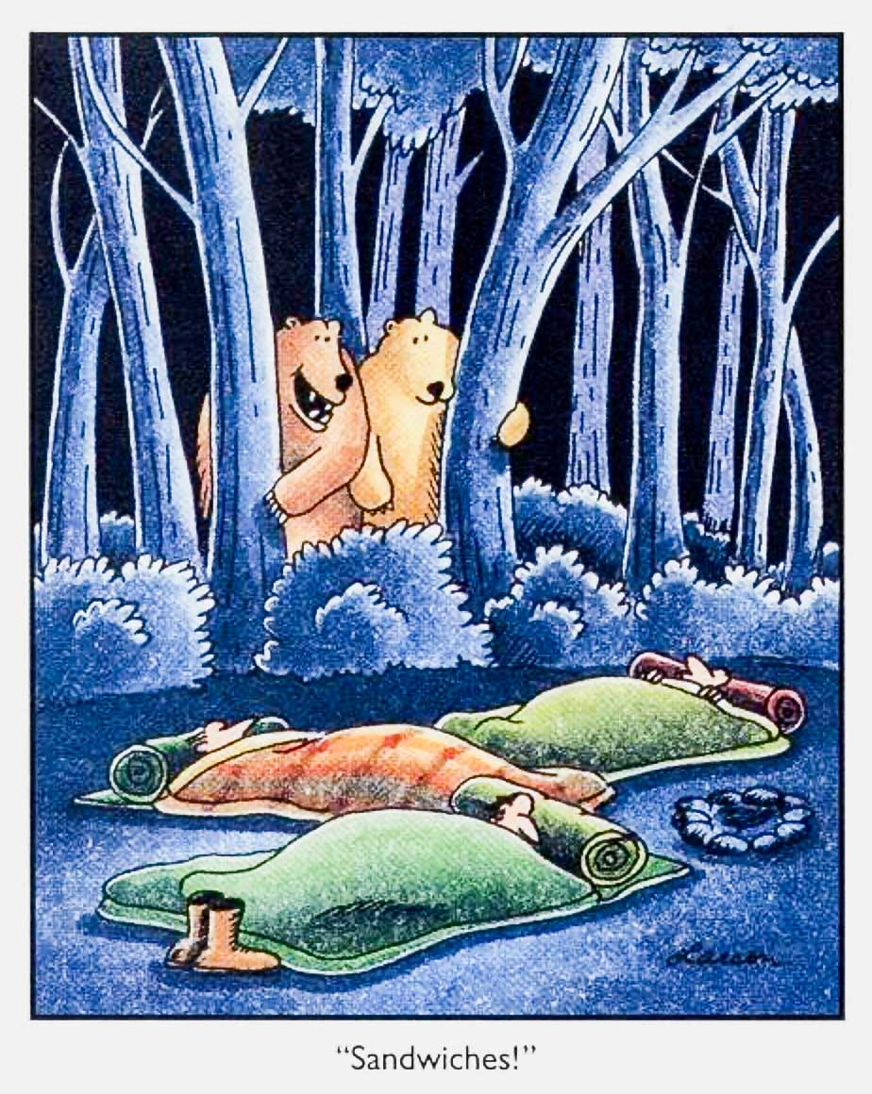
Leadership Techniques
In Case of Emergency
Be prepared with basic skills and knowledge
Think through an emergency plan for every trip
Become Familiar with Mountaineers emergency procedures – “Seven Steps”
Complete incident report when you close your trip
Notes:
Diann
Be prepared with basic skills and knowledge for how to handle basic first aid and other emergencies in the field
Think through an emergency plan for every trip
Will you have cell coverage? If not, what is your plan?
How would you describe your location?
Do you have emergency contact numbers?
Mountaineers emergency procedures – “Seven Steps” in leader resource materials
Complete incident report when you close your trip

Slide 19
Mountaineer Standards
Definition of a Hike
More than 2 miles
Restricted to trail / roads with some exceptions
Party Size
  Minimum party size is 3 (safety)
  Maximum party size is 12 (agency rules)
If posted on the website and led within these rules, The Mountaineers provides you and your participants with liability protection provided you are not grossly negligent.
Notes:
Beth or Carolyn
More than 2 miles
Restricted to trail / roads with some exceptions
Snow is okay unless there is the potential for an uncontrolled slide
Off trail is okay unless the terrain is unreasonably hazardous
Depends on the skills of the particular group
Party Size
Minimum party size is 3 (safety)
Maximum party size is 12 (agency rules) unless lower limits apply
If posted on the website and led within these rules, The Mountaineers provides you and your participants with liability protection provided you are not grossly negligent.

Slide 20
Mountaineers Standards
Legal Considerations
Even as volunteers, we have a legal DUTY OF CARE to follow the STANDARD OF PRACTICE in our industry to keep participants safe.
Volunteers are protected from individual liability by Federal and State statute and The Mountaineers insurance as long as they are not “grossly negligent”.
Know and follow The Mountaineers guidelines and policies at all times.
Notes:
Beth or Carolyn
Even as volunteers, we have a legal DUTY OF CARE to follow the STANDARD OF PRACTICE in our industry to keep participants safe and deliver what we promise.
Volunteers are protected from individual liability by Federal and State statute and The Mountaineers insurance as long as they are not “grossly negligent” – but the club can be sued based on your actions (or lack of action)
Know and follow The Mountaineers guidelines and policies at all times (e.g. A hike should be a hike, not a scramble!)

Slide 21
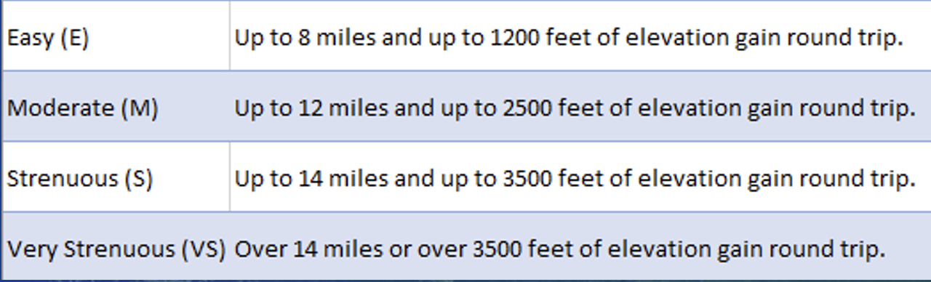
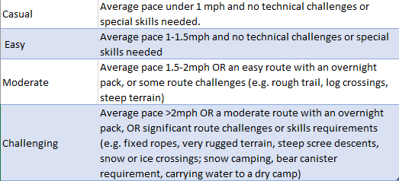
Mountaineers Standards
Difficulty Ratings
Difficulty (Route)
Leader Rating
The overall Difficulty Rating for a trip or route shall be the lowest rating that satisfies both the distance and elevation gain criteria. For example: a trip with 11 miles of distance and 1000 ft of gain would be a Moderate trip.
It is recommended that the leader clearly specify the distance and elevation gain for the route as well as their planned pace, any special technical challenges and special gear, skills and conditioning requirements of the trip in the trip posting within the activity summary and/or the leaders’ notes.
Notes:
Beth or Carolyn
The overall Difficulty Rating for a trip or route shall be the lowest rating that satisfies both the distance and elevation gain criteria. For example: a trip with 11 miles of distance and 1000 ft of gain would be a Moderate trip.
It is recommended that the leader clearly specify the distance and elevation gain for the route as well as their planned pace, any special technical challenges and special gear, skills and conditioning requirements of the trip in the trip posting within the activity summary and/or the leaders’ notes.

Slide 22
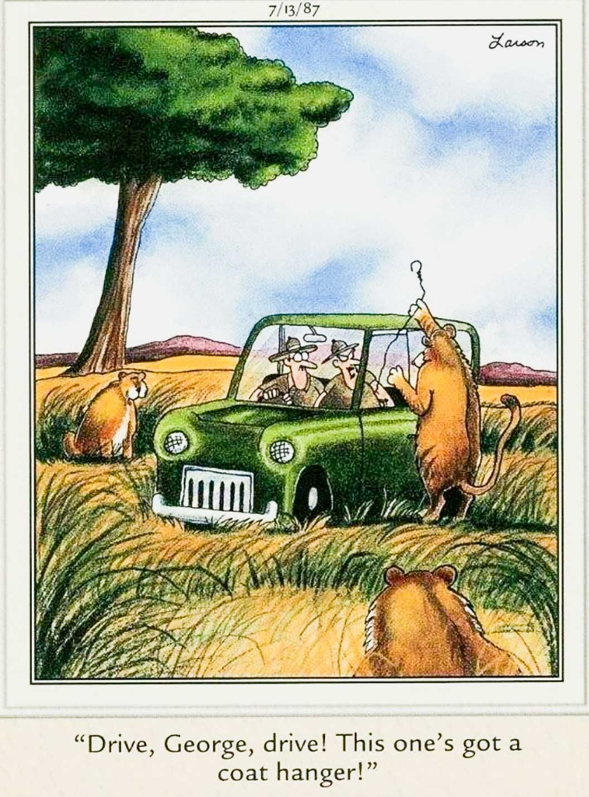
Mountaineer Standards
Running a Trip / Carpooling
Current State
Carpooling is Encouraged
Leaders CANNOT assign or require carpools
Willing drivers are a precious resource
Remind people that it’s an important courtesy to reimburse their driver
Notes:
Beth or Carolyn
Carpooling is Encouraged
Leaders CANNOT assign or require carpools
Leaders CAN encourage carpooling
Willing drivers are a precious resource
Remind people that it’s an important courtesy to reimburse their driver

Slide 23
Mountaineer Standards
Running a Trip / Privacy
Mountaineers members can make their profile data private
Trip leaders can see all the profile data of people on their roster, even private profiles
See Mountaineers website for Privacy Policy
Notes:
Beth or Carolyn
Mountaineers members can choose to make their profile data private
Our privacy policy states that the data of a person with a private profile cannot be shared with other members
Trip leaders can see all the profile data of people on their rosters, even those who have private profiles
Leaders may extract and use participant profile data, even when private, for planning and safety purposes relative to their trip or seminar
Leaders must ask permission before sharing even email addresses with other participants
https://www.mountaineers.org/membership/mountaineers-privacy-policy-explained

Slide 24
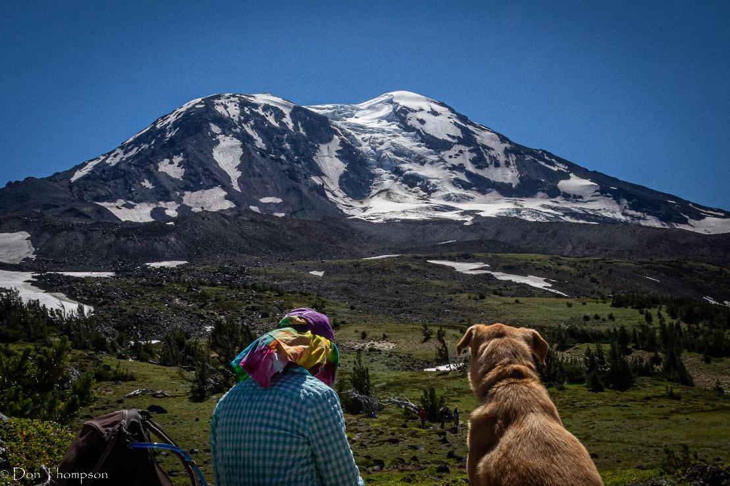
Mountaineer Standards
Pet and Service Dog Considerations
Hikes with Dogs
  Advise participants in advance in trip posting
  Follow posted trail rules
  No dogs in active wildlife areas
  Be sensitive in camps with other people
  Mountaineer policy for service animals
  Party size is twelve heartbeats
Notes:
Beth or Carolyn
Hikes with Dogs:
Establish in advance as part of the trip posting – don’t spring it on other participants after they’ve registered
Follow posted trail rules
Don’t bring dogs in active wildlife areas
Be sensitive to dogs in camps with other people
Party size is twelve heartbeats or less.
Service dog policy

Slide 25
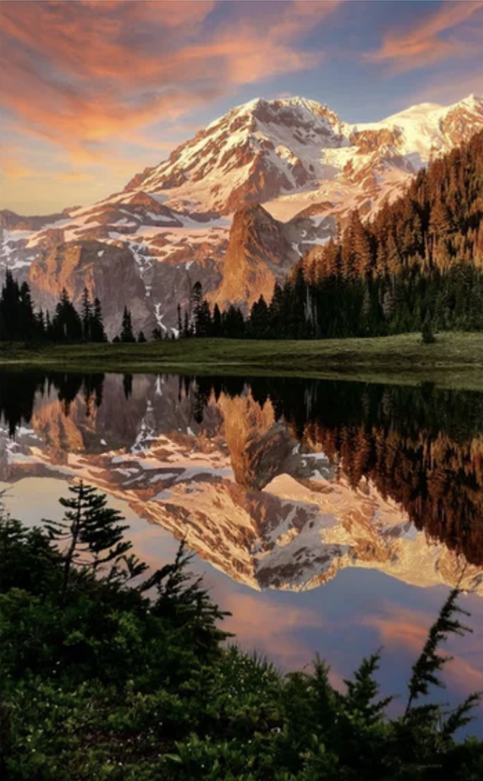
Running a Trip
2-3 Weeks Before the Trip
Choose a safe destination
Post the hike on the website, with clear and concise description of the route
Include highlights (what will I see?)
Notes:
David
Choose a safe destination given the conditions
Post the hike on the website, with clear and concise description of the route, difficulty rating, pace, hazards, physical and gear requirements
This detail is essential to allow participants to self-screen in / out of a trip
Include some highlights (e.g. old growth, fall colors, unique geology, stunning views, etc.)

Slide 26
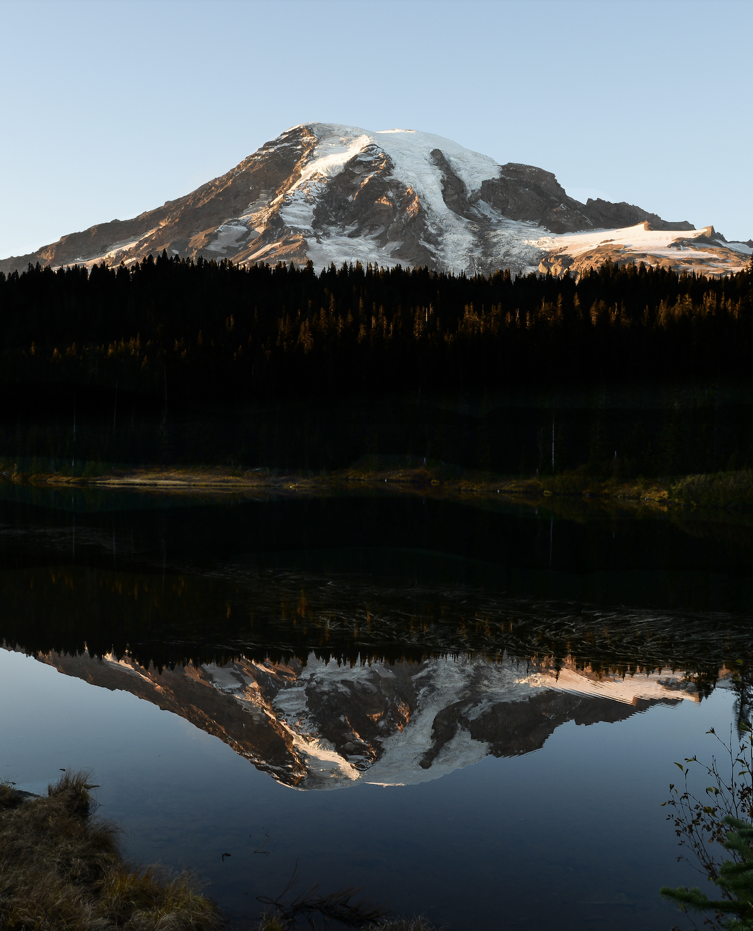
Running a Trip
3-7 Days Before the Trip
Check weather forecast, road & trail reports
Send out “Hello Hiker” email
Check the roster – screen participants
Notes:
David
Check the weather forecast, road and trail reports – do you need to adjust your destination or gear?
Send out the “Hello Hiker” email(s) to confirm meeting time & place, hazards and demands of the trip, review the route (and highlights), re-enforce gear requirements and encourage carpooling
Check the roster – screen participants
Do they have the conditioning and experience for the route planned?
You have the right and obligation to remove someone if they are not prepared for a safe trip

Slide 27
Running a Trip
Roster Management
Changes to the roster and waitlist are common and frequent!
Enable Notify Leader of Registration Changes
  Check this box for the primary leader to receive an email notification when there are updates to the activity roster.
Check roster for cancellations and additions a couple of times after you send the “Hello Hiker” email, and always the day before your trip. Print the final list or save to your phone.
Send the “Hello Hiker” email to anyone who has been added from the wait list and conduct any necessary screening.
Report no-shows when you complete your trip report and close the activity.
Notes:
David
Enable Notify Leader of Registration Changes
Check this box for the primary leader to receive an email notification when there are updates to the activity roster.
Schedules are fluid and changeable, and Mountaineer hikers are known to change their minds! Cancellations the week of the hike are common, opening spots for people on the wait-list. After you send your “hello hiker” email, be sure to check the roster for changes. Always make one final check the evening before your hike, and make sure you have a copy of the list to take with you. The list is important, not only to check off participants at the meeting point, but also to have the emergency contact information.
If new people have been added, either from the wait-list or as new registrants, send them the “hello hiker” email and conduct any necessary screening.
After the trip, remember to report any no-shows when you complete your trip report and close the activity.

Slide 28
Running a Trip
Running a Trip / Screening Participants
Most problems reflect a poor match of capabilities / interests
Set expectations with hike descriptions and pre-trip communications
Consider using the “Leader Permission Only” option
Check a participant’s activity and course history on the website
When in doubt, contact the participant
Notes:
David
Most problems on hikes or backpack trips reflect a poor match of participant capabilities / interests with the planned activity
Set expectations with clear activity descriptions and pre-trip communications / this helps participants self-screen in or out
If your trip requires certain skills and/or conditioning
Consider using the “Leader Permission Only” option
Check a participant’s activity and course history on the website
You may need to contact the participant via email or phone
It can be awkward and frustrating, but don’t hide from this. It has a big effect on the success and safety of the trip!
Ask detailed, but considerate questions about recent activities they’ve been on. Who led? Pace (or how long the trip took)? How they felt after the trip?
Be fair and as inclusive as possible. Decide based on relevant facts, not hearsay or demographics. Can you accommodate a slower pace?
Be caring and respectful. Explain your goal is to ensure that everyone has a fun and safe trip. Suggest an alternate activity if yours isn’t a fit.
If a person doesn’t respond or isn’t prepared, you have the right to turn them down or cancel them from your roster.

Slide 29
Running a Trip
Running a Trip / At the Meeting Place
Arrive at meeting place 10 minutes early
The “Meeting Place” may be prior to the trailhead or the trailhead
Provide directions to trailhead and info on the right permits
Introductions. Introduce yourself as leader, check off names on roster
Check for essential equipment before people leave their vehicles and switch to carpools
Notes:
David
Arrive at meeting place 10 minutes early
The “Meeting Place” may be prior to the trailhead; participants are ultimately responsible for getting themselves to the trailhead
Be sure that everyone has directions to the same trailhead and the right permits
Introductions. Introduce yourself as leader, check off names on roster
Check for essential equipment before people leave their vehicles and switch to carpools (boots, rain jackets, critical gear for this trip)

Slide 30
Running a Trip
At the Trailhead
Introductions and ice-breaker
Emphasize that Mountaineers travel as a group
Leader reserves the right to make the call for safety
Review the map
Encourage open, respectful communication of safety concerns
Ask for volunteers to be first-aid leader and sweep
Address the procedure for bathroom breaks (“party separations”)
Safety first! The group will turn around if the conditions are unsafe
Notes:
Diann
Introductions and ice-breaker
Begin by emphasizing that Mountaineers travel as a group – we make decisions as a group, when possible, but as the leader you reserve the right to make the call for safety
Review the map – route, junctions, hazards, handrails, rest stops, water stops, lunch, camp, turnaround time (and stick to it!)
Explain how you intend to manage the pace and when / where to regroup
Each person is responsible to know how to get back to the trailhead
Encourage open, respectful communication of safety concerns and remind everyone that we all watch out for each other and finish together as part of a Mountaineers group
Ask for volunteers to be first-aid leader and sweep
Trip leader and first-aid leader should be different so you can manage a crisis
Define the first-aid leader and sweep responsibilities for the whole group
Address the procedure for bathroom breaks (“party separations”)
Safety first! The group will turn around if you judge the conditions to be unsafe
Get the Trailhead communications right and you will avoid many common issues on the trail

Slide 31
Running a Trip
During the Trip
Manage the pace for the safety and morale of everyone in the group.
Stay vigilant for participant, weather or route issues.
Stop and help struggling participants.
Lead for the whole group’s success!
If the conditions change, find a safer alternative or turn around.
Don’t be afraid to make an unpopular call if YOU believe it’s important for the safety of the group.
Notes:
David
Manage the pace for the safety and morale of everyone in the group.
Decide based on experience, conditions and trail hazards whether to keep the group together or let them spread out. Always maintain line of sight.
Participants should wait for the leader at junctions, significant stream crossings or hazards.
Stay vigilant for participant, weather or route issues. Stop and help struggling participants.
Look for fatigue clues and adjust as needed
Lead for the whole group’s success! Don’t go beyond the capabilities of the weakest or least skilled members.
If the conditions change or the route proves more difficult than the weakest member can complete safely, find a safer alternative or turn around
Lead the trip you posted (a hike is not a scramble).
Gather the facts, listen, discuss alternatives, but also be decisive and confident. Explain your rationale and relate it to the safety of the group.
Draw out the quiet people. Watch for the “herd mentality.”
“Majority rule” or consensus can work in some situations, but not all.
Don’t be afraid to make an unpopular call if YOU believe it’s important for the safety of the group. YOU are responsible for the group’s SAFE RETURN to the trailhead.

Slide 32
Running a Trip
End of the Trip/After the Trip
Make sure everyone is back to the cars
Short debrief, thank everyone for participating
Wait to be sure that all vehicles start and everyone is on their way.
Once home, close the trip and include any necessary participant notes
Report any safety incidents. (Note that participants also have an opportunity to report incidents as part of the trip evaluation.)
In the case of an incident involving serious injury, follow-up per Mountaineer guidelines.
Notes:
David
At the end of the trip, it’s important to make sure that everyone has returned to the trailhead.
Most leaders like to have a quick debrief at the end of the day and wish everyone a safe drive home.
Make sure all the vehicles start! This is particularly important in areas that are subject to trailhead vandalism and theft.
Once you are home, go online and close the trip. If there are any concerns about any of the participants, note the concerns when you are closing the trip.
As part of the closing process, you can also report any safety incidents. These can include significant “near misses” and injuries.
In the case of an incident involving an injury, it’s a good idea to follow up with the individual.
Be familiar with the guidelines for emergency response!

Slide 33
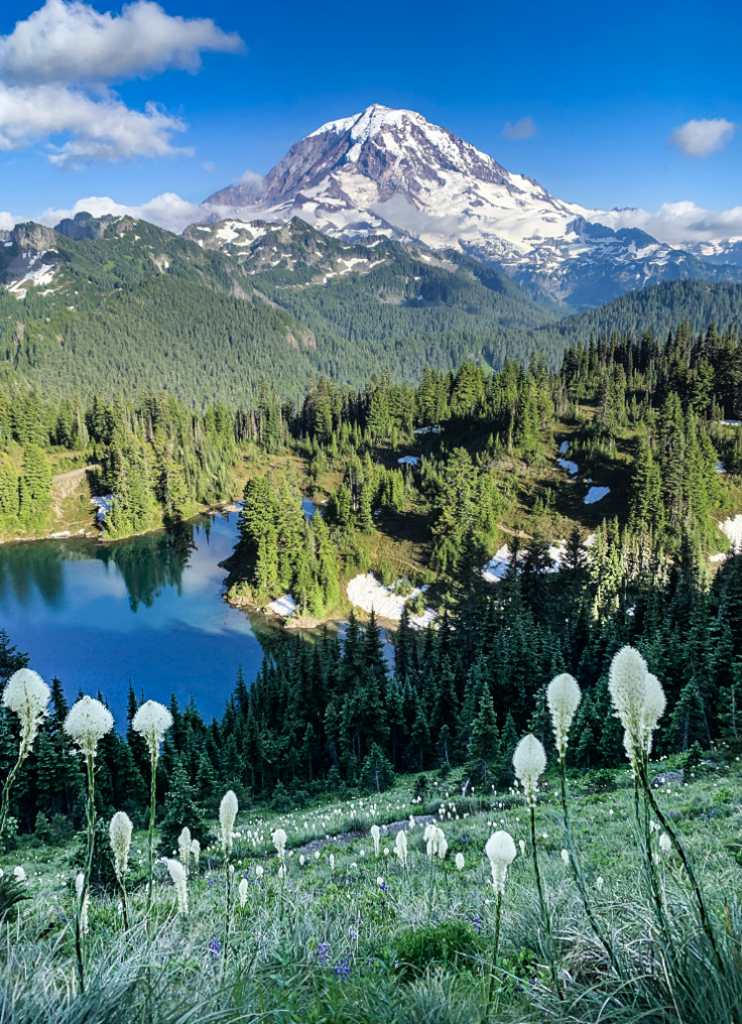
Running a Trip
Leader Checklists
Review the Leader Checklists on the Leader Resources page
Before the hike
At the meeting place
At the trailhead
On the trail
In case of emergency
After the trip
Notes:
David
Review the Leader Checklists on the Leader Resources page and be familiar with the expectations at each stage. Checklists include:
Before the hike
At the meeting place
At the trailhead
On the trail
In case of emergency
After the trip

Slide 34
Leadership Techniques
Scenarios
Injuries or trip problems often result from system failures or leader decisions that can be examined to prevent recurrence.
Discussion groups with facilitator
Discuss your scenarios, choose one to report out to group.
Listen and consider taking notes from other groups’ report outs.
Notes:
Lisa
Injuries or trip problems often result from system failures or leader decisions that can be examined and addressed to prevent recurrence.
Next we’ll explore in greater depth how to respond to some common ‘judgment’ situations using what you’ve learned today
Discussion groups with facilitator
Discuss your scenarios, choose one to report out to group
Listen and consider taking notes from other groups’ report outs

Slide 35
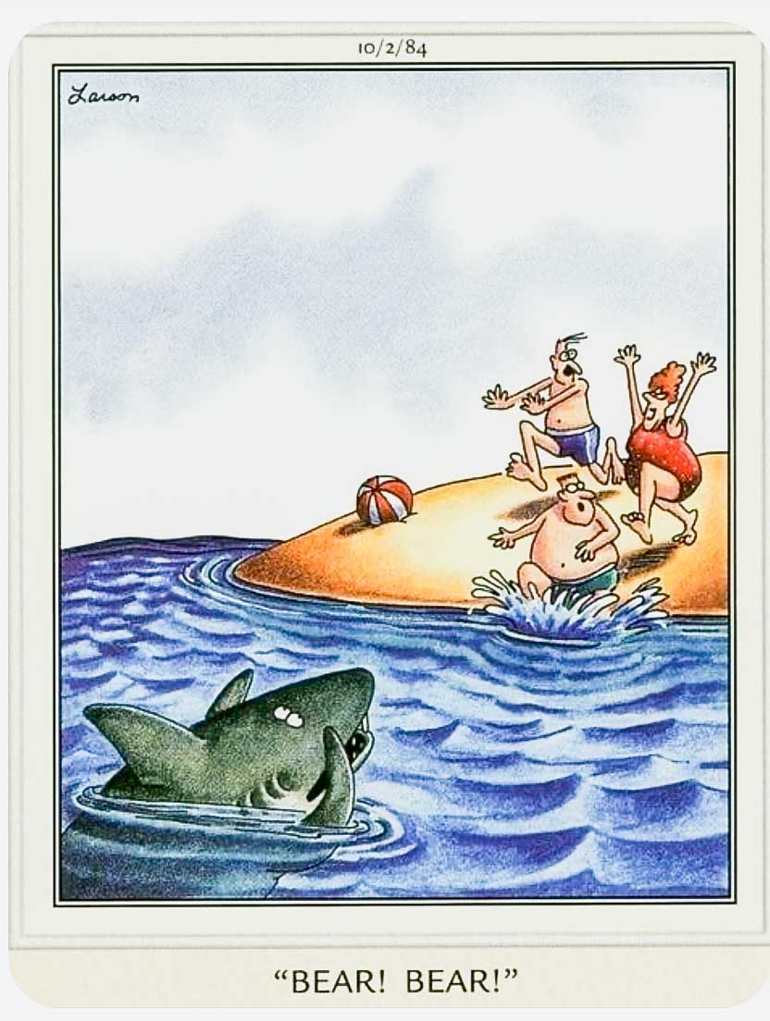
Wrap Up
Other Considerations
Leaders must be approved on the leader roster to post and lead a trip
You can request additional mentoring or post trips with a co-leader at any time
Urban Walk Leader Badge
  The Tacoma Branch does not currently offer the Urban Walk Leader Badge. If you’re interested in becoming an Urban Walk Leader, please complete a separate application to a different branch.
Notes:
Lisa
Leaders must be approved on the leader roster for a sponsoring hike/backpack committee to post and lead a trip
You can request additional mentoring or post hikes with a co-leader at any time
Urban Walk Leader Badge
The Tacoma Branch does not currently offer the Urban Walk Leader Badge. If you’re interested in becoming an Urban Walk Leader, please complete a separate application to a different branch.

Slide 36
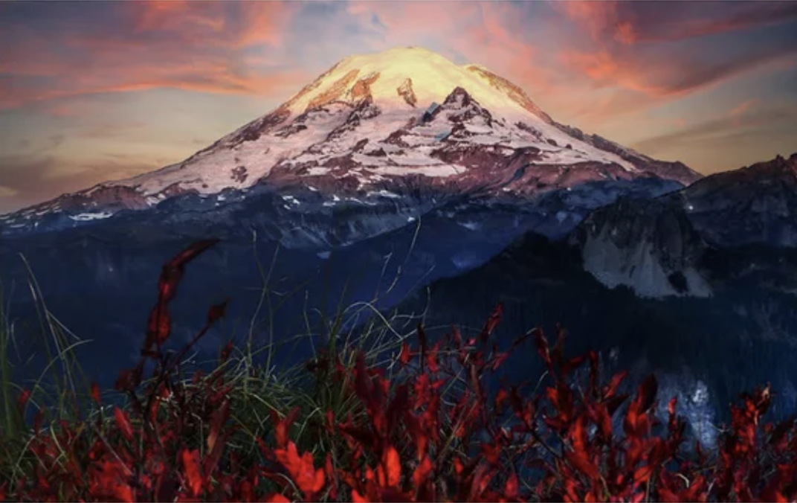
Questions?
Notes:
All facilitates Q&A

